Slide 1
IoT Analytics
Evaluating Techniques for Wifi Locationing
ALESSANDRO ARNONE

Slide 2

INTRODUCTION
01
PREPROCESSING
02
03
MODELLING AND ERRORS
04
Q&A

Slide 3
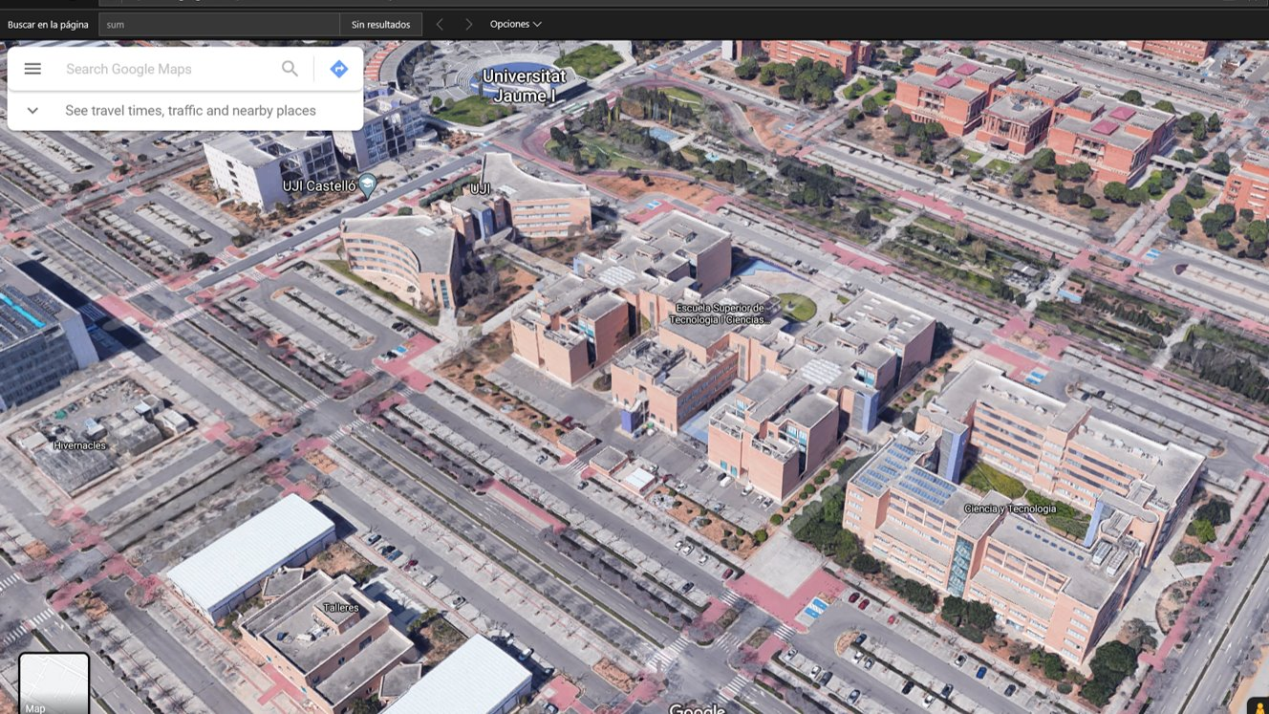
Introduction
21049 observations
- 19938 training
- 1111 validation (4 months after Training ones)
Wireless access points (WAPs) = 520
3 buildings - > 4/5 floors
20 users | 25 mobile devices

Slide 4
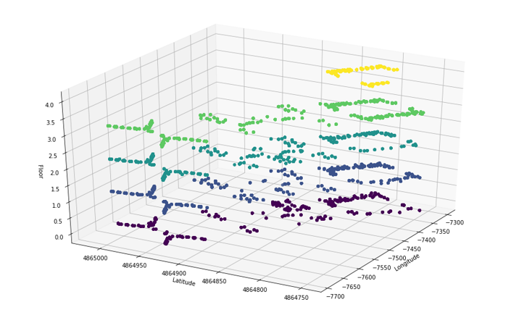
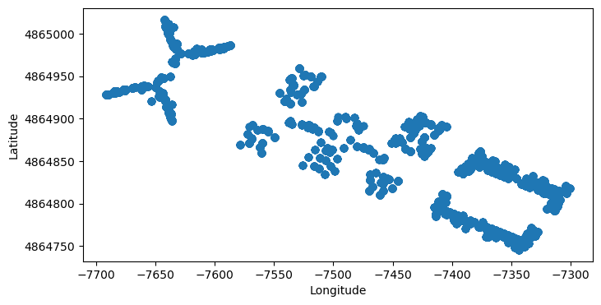
Introduction
GOAL
To predict positioning regarding WAP signals
(BUILDING) + LONGITUDE + LATITUDE + FLOOR
Known positions in training set

Slide 5
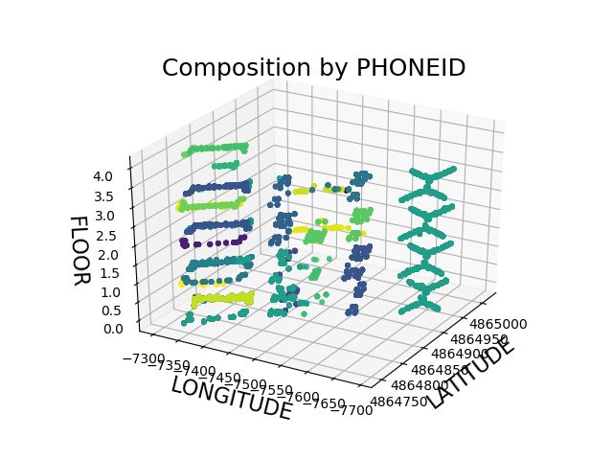
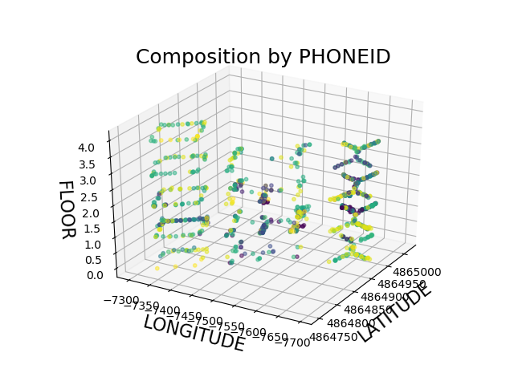
Introduction
TRAINING
VALIDATION
Challenges
Training set not representative
High number of predictors
Notes:
*user id building 0 the same -> could have accuracy building=1
*we can clearly see the path of the PhoneID ->

Slide 6
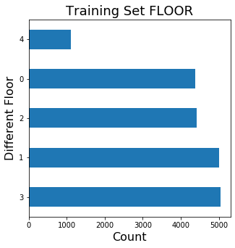
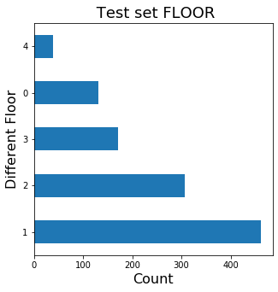
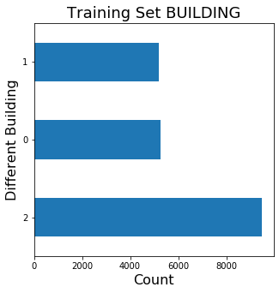
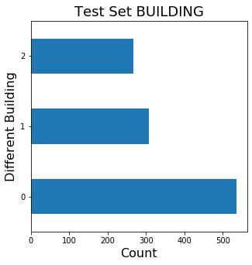
Introduction
Class Imbalance

Slide 7
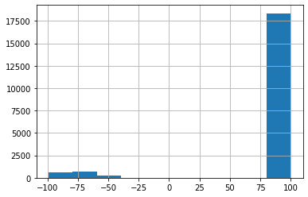
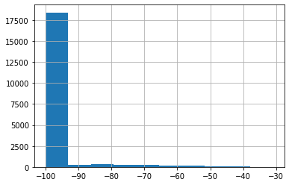
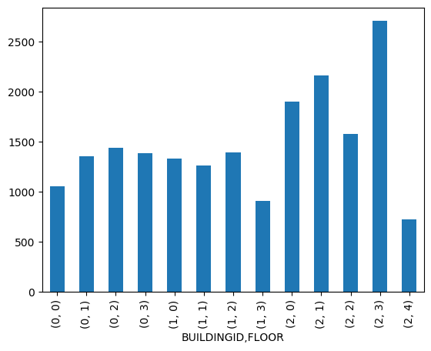
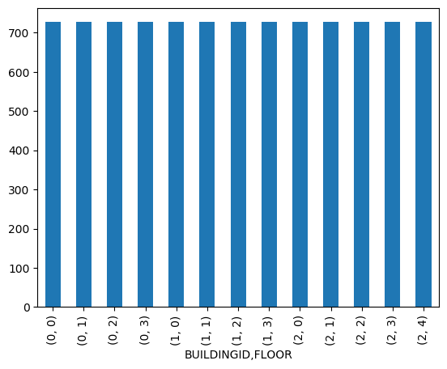
Preprocessing results
Drop duplicates
100 = - 100
Frequency
Frequency
Remove low variance rows
Remove low variance columns
RSSI level
RSSI level
Balance classes
From 520 to 260 predictors
From 19937 rows to 15053
Normalize data
Notes:
*normalize data -> on rows -> every rows is an observation -> there might be phone more powerful then other -> so we normalize by rows
*low variance rows-> rows that are almost duplicates
*low variance columns -> similiar to have a columns witht the same value

Slide 8
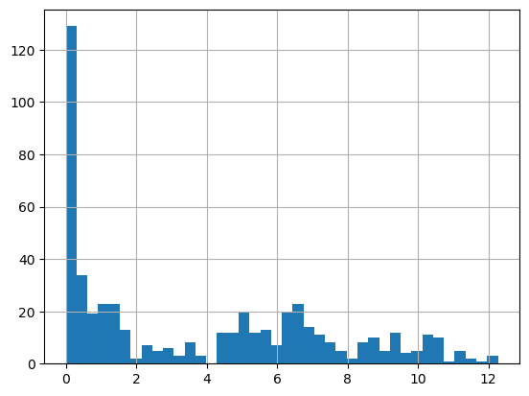
Preprocessing results
REMOVE LOW VARIANCE COLUMNS
SD DISTRIBUTION
REMOVED VARIABLES

Slide 9
MODELS

Slide 10
Building Prediction
PREDICTORS
maximum WAP observed
 | Prediction B0 | Prediction B1 | Prediction B2
B0 | 536 | 0 | 0
B1 | 0 | 307 | 0
B2 | 0 | 0 | 268
ACCURACY
1
MODEL
Logistic Reg.
ADDITIONAL INFO
Only 8 WAP were the best over multiple buildings amongst 9k+ observation

Slide 11
Floor Prediction
PREDICTORS
260 WAPS intensity
FLOOR | B0 |  |  |  |  | Total Observation | ACCURACY
1 | 75 | 0 | 0 | 0 |  | 78
2 | 4 | 203 | 1 | 0 |  | 208 | 0,97
3 | 2 | 4 | 159 | 0 |  | 165
4 | 0 | 0 | 2 | 83 |  | 85
 | B1
1 | 22 | 3 | 5 | 0 |  | 30
2 | 4 | 89 | 42 | 1 |  | 136
3 | 0 | 0 | 73 | 6 |  | 79 | 0,758
4 | 0 | 0 | 2 | 45 |  | 47
 | B2
1 | 21 | 3 | 0 | 0 | 0 | 24
2 | 0 | 107 | 4 | 0 | 0 | 111
3 | 0 | 3 | 47 | 2 | 2 | 54 | 0,93
4 | 0 | 0 | 2 | 35 | 3 | 40
5 | 0 | 0 | 0 | 4 | 35 | 39
ACCURACY
0.90
MODEL
kNN
ADDITIONAL INFO
Worst Accuracy in Building 1

Slide 12
Longitude/Latitude Prediction
PREDICTORS
260 WAPS intensity
Predictor | Building | Method | HyperParameters | Score | RMSE
Longitude | 0 | k-NN | 3n | 0,978 | 6.60
Longitude | 1 | k-NN | 3n | 0,982 | 8.32
Longitude | 2 | k-NN | 4n | 0,962 | 10,6
Latitude | 0 | k-NN | 2n | 0,99 | 5,72
Latitude | 1 | k-NN | 3n | 0,98 | 10,77
Latitude | 2 | k-NN | 2n | 0,957 | 9,04
ACCURACY
LATITUDE: 8.25
LONGITUDE: 8.18
MODEL
kNN
ADDITIONAL INFO
Worst Accuracy in Building2 and Building 3

Slide 13
ERROR ANALYSIS

Slide 14
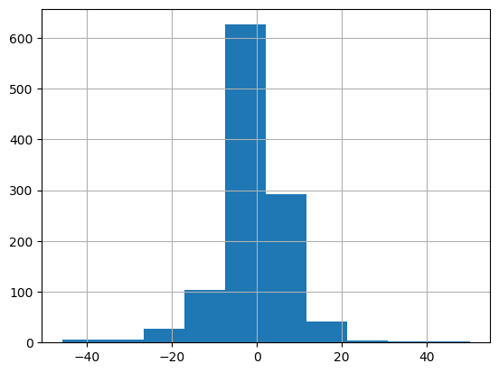
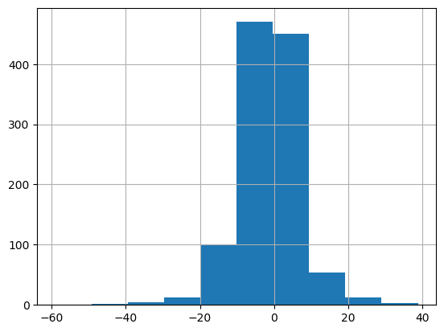
Error Analysis
ERROR DISTRIBUTION LATITUDE
ERROR DISTRIBUTION LONGITUDE

Slide 15
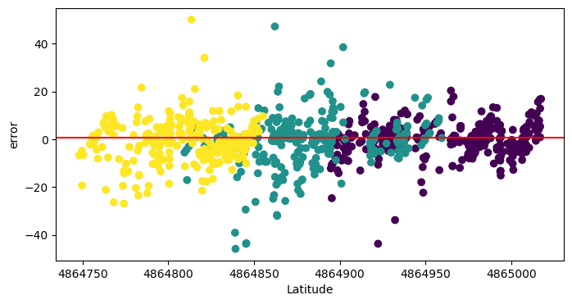
Error Latitude
ERROR DISTRIBUTION LATITUDE
BUILDING 1
BUILDING 2
BUILDING 3

Slide 16
Error Analysis
ERROR DISTRIBUTION LATITUDE
ERROR DISTRIBUTION LONGITUDE

Slide 17
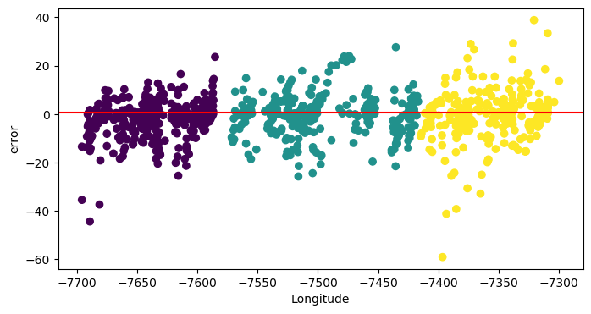
Error Longitude
BUILDING 0
BUILDING 1
ERROR DISTRIBUTION LONGITUDE
BUILDING 2

Slide 18
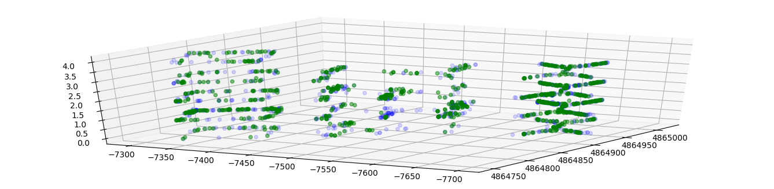
Final Prediction
OBSERVED VALUES
PREDICTIONS

